Slide 1
Remote Vehicle Interaction Architecture
An open source solution for the automotive industry
Magnus Feuer - Jaguar Land Rover
Rudolf Streif – Jaguar Land Rover
© 2014 Jaguar Land Rover

Slide 2
Background
80% of connected vehicle functionality shared across platforms
Core IVI and Server functionality are similar, regardless of vendor. The final 20% are the services that defines the user experience.
A shared, open source platform will benefit OEMs
A joint architecture and reference implementation allows OEM to minimize cost, vendor dependencies, and security risks, letting them focus on applications and services that make a difference.
A shared, open source platform will benefit service providers
A common architecture allows service providers to easily port their products to additional OEMs, thus giving them a wider revenue stream from multiple vendors.
Notes:
It is time to stop re-inventing the wheel

Slide 3
What we are doing
The Problem
How do we allow an in-vehicle application to exchange data with other devices and servers in a simple, robust and secure manner, regardless of connectivity?
The Solution
Build open source technology to handle authentication, authorization, discovery, and data exchange between services in a sparsely connected P2P network.
The Goal
RVI is accepted by the automotive industry as a secure, reliable, and
proven technology choice for connected vehicle projects.
Notes:
It is time to stop re-inventing the wheel

Slide 4
Benefits
Enable new breed of 3rd party service providers
Open source implementation enables start-ups to develop in-vehicle apps and their corresponding backend services, and showcase the finished product to OEMs.
Alleviate vendor dependency
OEM can replace components at will, using either external or internal resources. All IP of the replaced components belongs to the OEM.
Wider talent pool
Large competence base provided through open source community, OEMs, app developers, and professional service vendors.

Slide 5
Feature Set
Peer-to-peer based
Two nodes can exchange services without an internet connection.
Provisioning
Services and nodes can be added and deleted from the system.
Authentication & authorization
All executed services are authenticated and authorized against certified credentials.
Service discovery
Services and applications can discover and invoke other services.
Invocation
Services can be remotely invoked over a sparsely connected network.

Slide 6
Status
RVI Expert Group Formed
RVI Expert Group is up and running
Wiki and Code Repos Setup
http://wiki2.automotivelinux.org/eg-rvi
http://github.com/PDXostc/rvi
Design Completed and Validated
Rich High Level Description document available at Wiki.
Version 0.2 Released
Handles core service discovery and transactional routing.
Remote HVAC Demo + Video Released
Real-time mirrored HVAC UI between Tizen in Jaguar F-type and mobile device.
Software-over-the-Air (SOTA) Demo + Video released
Updating software packages over-the-air by pushing them from a web-based server backend.
Big Data Demo WIP
Collecting data (location, speed) from vehicles and vizualizing them on the web backend.

Slide 7
Upcoming Demos
Remote HVAC Demo
Real-time mirrored HVAC UI between Tizen in Jaguar F-Type and mobile device.
Software Over The Air (SOTA) - Telematics Update San Diego Oct 30-31
Transfer, install, and validate a software package from a backend server to an IVI unit.
Big Data Collection and Visualziation – CES 2015, Las Vegas, Jan 6 – 8, 2015
Remotely subscribe to specific CAN frames, and have them delivered to a backend server.

Slide 8
Use-Case Demos

Slide 9
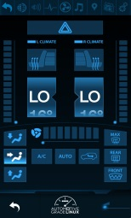
HVAC Control Architecture
Mobile Device – 192.168.0.2
Mobile Application Sends Command
HVAC App sends an message, targeting a given service URI, to Service Edge.
Locate Target Node
Service Edge asks local service Service Discovery to resolve service name to a network address.
Return Network Address
Specifies where the target service can be reached.
Send Request to Vehicle
The vehicle data router processes the command.
Forward Request to HVAC Service
The HVAC Service in the vehicle executes the command.
{
"method": "call",
“service”: “jlr.com/vin/1234/set_fan”
"params": {
“callback": "http://localhost/hvac_app”
"arguments": {
“speed": 7
} } }
1
HVAC App
Service Edge
2
4
3
Service Discovery
jlr.com/vin/1234/hvac -> http://192.168.0.1/hvac
Vehicle – 192.168.0.1
HVAC Service
5
Data Router

Slide 10
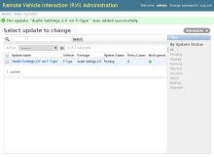

SOTA Architecture
Web Backend Notifies Vehicle of Update
Web Backend sends update notification for a software package.
Locate Target Node
Service Edge asks local service Service Discovery to resolve service name to a network address.
Return Network Address
Specifies where the target service can be reached.
Send Request to Vehicle
The vehicle data router processes the command.
Forward Request to SOTA Service
The SOTA Service in the vehicle shows update details on the screen and waits for user confirmation.
Vehicle Response to SOTA Server
Response from vehicle gets relayed to the SOTA server which then starts sending the software package or aborts the transaction based on the response.
SOTA Server Sends Software Package to Vehicle in Chunks
The software package is split up into chunks and sent to the vehicle. SOTA Service assembles the chunks into the package.
SOTA Service Installs Package
SOTA Service installs package and reports installation status back to the SOTA Server.
Backend Server
Database
Web Backend
SOTA Server
1
7
Service Edge
2
4
RVI
3
Service Discovery
jlr.com/vin/1234/sota -> http://192.168.0.1/sota
6
Vehicle – 192.168.0.1
SOTA Service
8
5
Data Router
6
7
8

Slide 11
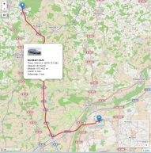
Big Data Architecture
Web Backend Notifies Vehicle of Data Subscription
Web Backend sends a data subscription message to the vehicle.
Locate target node
Service Edge asks local service Service Discovery to resolve service name to a network address.
Return network address
Specifies where the target service can be reached.
Send request to Vehicle
The vehicle data router processes the command.
Forward request to Big Data Service
The SOTA Service in the vehicle shows update details on the screen and waits for user confirmation.
Vehicle Sends Data to Big Data Servers
The vehicle collects the subscribed-to data and sends it to the Big Data Server in regular intervals. If the server cannot be reached the data gets cached.
Big Data Server Receives Data
The Big Data Server receives the data and stores it in the Backend Database.
Big Data Server Provides Realtime Update to Web Backend
The Big Data Server sends data updates in realtime to the web clients who subscribed to the data through the web backend.
Backend Server
Database
7
Web Backend
Big Data Server
8
1
Service Edge
2
4
RVI
3
Service Discovery
jlr.com/vin/1234/sota -> http://192.168.0.1/sota
6
Vehicle – 192.168.0.1
Big Data Service
5
Data Router
6

Slide 12

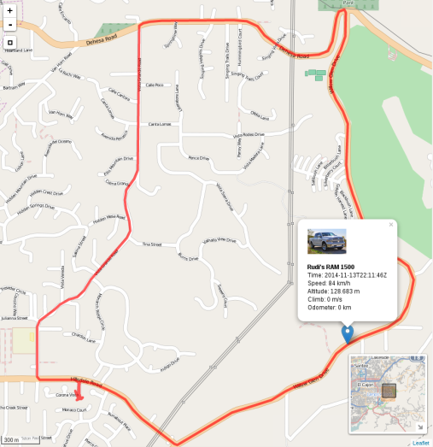
Big Data Use Cases
Vehicle Tracking Information
Show vehicle locations and travel
Filter by date and time
Display vehicle status information for every waypoint
Vehicle Tracking Animation
Marker moves along traveled path
Display vehicle status information for every waypoint

Slide 13
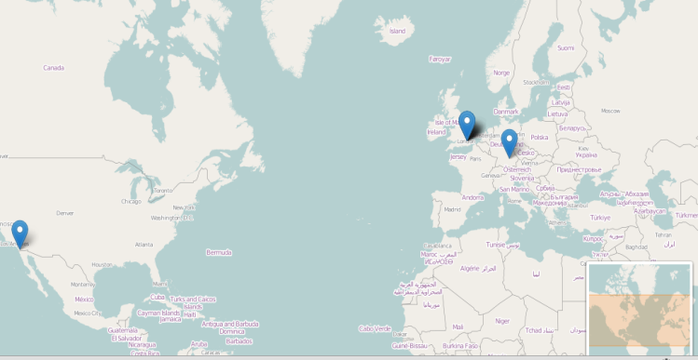
Big Data Use Cases
Vehicle Locations
Show locations for any number of vehicles
Filter by date and time
Realtime Tracking
Track positions and vehicle data in realtime as information is sent from the vehicles to the Big Data Server
Filter by date and time

Slide 14
RVI Architecture

Slide 15
Architecture - Overview
Vehicle
API based
  The API is the driving technology. Implementation is secondary.
Data Router commonality
  Data Router connects all services on all devices.
  Mix of open and closed source
  Components can be off the shelf, OSS, proprietary, or a combination of the above.
  Network complexity shielding
  A clean transaction API alleviates services and applications from connectivity concerns.
App1
App2
App3
Browser
IVI Platform
HTTP / HTML5
Cloud
RVI Plugin
Charging & Billing Service
Customer Portal Web Service
Provisioning Service
Control Unit
CAN
JSON-RPC
JSON-RPC
JSON-RPC
JSON-RPC
Service
Data Router
JSON-RPC
Remote Vehicle Access Manager
Data Router
SMS / 2.5G / 3G/ LTE / WiFi / Bluetooth
JSON-RPC
JSON-RPC
JSON-RPC
Mobile Device
Software Over The Air Service
Analytics / Big Data
Data Router
3rd party Service
3rd party service
3rd party service
App
GENIVI-developed component
3rd party reference component
OEM/3rd party proprietary component
Off the shelf component

Slide 16
Architecture – Data Router
Service Edge
Handles all traffic toward locally connected services.
Authorization
Handles certificates and authorization for all traffic.
Schedule
Handles traffic store and forward for unavailable destinations.
Data Link
Controls communication channels to other node.
Service Discovery
Identifies and locates local and remote services.
Protocol
Encodes and transmits traffic to other nodes.
Vehicle
XWalk App
XWalk
RVI/ XWalk Plugin
E911
Trigger
SOTA
Manager
Data Router
Service Edge
Schedule
Authorization
Protocol
Service Discovery
Data Link
GENIVI-developed component
3rd party reference component
OEM/3rd party proprietary component
Off the shelf component

Slide 17
Architecture – Backend Server
Data Router
Standard deployment.
Provisioning
Creates and distributes certificates granting access rights to nodes.
SOTA server
Manages and distributes software packages to nodes.
Cloud / TSP
E911
PSAP
Media
Server
Remote Vehicle Access Manager
SOTA
Server
Provisioning
Data Router
Service Edge
Schedule
Authorization
Protocol
Service Discovery
Data Link
GENIVI-developed component
3rd party reference component
OEM/3rd party proprietary component

Slide 18
Services

Slide 19
Services – Requirements
Global namespace for all services on all nodes, worldwide
All services on all provisioned devices must be addressable through a single schema.
Localized service discovery
Locally connected nodes must be able to discover each other's services without Internet access.
Zero configuration
No configuration outside authorization shall be needed for a newly deployed node to join the system.
Network agnostic
A service shall be accessed the same way, regardless of the communication method used.

Slide 20
Services – Addressing
Single name space for all services
New services can be addressed by creating a unique name for them.
Service name identifies hosting node
Each service name, being unique across the system, carries enough information for Service Discovery to identify where the node can be found.
Hide network complexity
All service interaction with other services are done through the service name space, allowing the actual communication to be carried out behind the scenes.

Slide 21
Services – Service Name Example
1
2
3
4
5
jaguarlandrover.com/vin/sajwa71b37sh1839/body/lock
# | Name | Description
1 | Organization | Specifies a sub-section hosted by a specific entity
2 | VIN sub-tree | Specifies sub section for all vehicles
3 | VIN | Vehicle Identification Number
4 | Service name | Name of service
5 | Command | Command supported by service

Slide 22
Services - Routing
Mobile Device – 192.168.0.2
Application sends command
HVAC App sends an message, targeting a given service URI, to Service Edge.
Locate target node
Service Edge asks local service Service Discovery to resolve service name to a network address.
Return network address
Specifies where the target service can be reached.
Send request to Vehicle
The vehicle data router processes the command.
Forward request to HVAC Service
The HVAC Service in the vehicle executes the command.
{
"method": "call",
“service”: “jlr.com/vin/1234/set_fan”
"params": {
“callback": "http://localhost/hvac_app”
"arguments": {
“speed": 7
} } }
HVAC App
1
Service Edge
2
4
3
Service Discovery
jlr.com/vin/1234/set_fan -> http://192.168.0.1/hvac
Vehicle – 192.168.0.1
HVAC Service
5
Data Router

Slide 23
Authorization

Slide 24
Authorization – Overview
Certificate based
Certificates, signed by a trusted provisioning server, grants node access to services.
Self-carried authorization
A node presents its certificates to another node to access its services, without provisioning server connection.
Service – service specific certificates
A certificate authorizes a specific set of services to access another specific set of services, and cannot be used outside that context.

Slide 25





Authorization – Use Case
Create and sign certificate
A certificate granting access to the mobile device is created and signed with provisioning server's private key.
Distribute certificate to mobile device
The targeted device receives its certificate
Send request and certificate to Vehicle
The certificate states that mobile device has the right to execute the given request
Validate credentials
The certificate and request is validated by the vehicle through a root certificate
Execute request
The validated command is forwarded to the target service for execution
Provisioning Server
1
Provisioning Server private key.
jlr.com/mobile/+447412123123 -> jlr.com/vin/1234/set_fan
Backend Server
2
Vehicle 1234
5
Execute set_fan
Mobile Device
3
root certificate
4
+
set_fan

Slide 26
Authorization – Examples
Access List Format
[organization]/[path]
+ wildcards
jaguarlandrover.com/vin/sajwa71b37sh1839/body/lock
Specifies a specific vehicle's lock command in the body service.
jaguarlandrover.com/vin/*/media/volume
Specifies the volume control command of the media service on all vehicles.
jaguarlandrover.com/cloud/vehicle_tracking/*
Specifies all commands under the vehicle_tracking service.

Slide 27
Authorization – Topics not covered
Protection of certificate inside a node
A credential received by the mobile device needs to be secured in accordance with the mobile device/IVI/server platform
Certificate – device binding
A stolen certificate can be presented by another device to gain service access. Device binding is done on an implementation level using hardware-specific mechanisms
Secure communication
Protocol implementations are responsible for securing data transmission between nodes using SSL/TLS or similar technologies

Slide 28
Conclusion
Connected Vehicle architecture for next generation services
Open source design, specification, and reference implementation
Benefits the whole industry
Hosted and driven by GENIVI

Slide 29
Next Steps
Joint projects
OEMs and other industry actors are being invited to collaborate under the AGL banner.
Continued technical development
The RVI reference system is incrementally implemented, with demos released as proof of concept and progress.
Widen scope to IOT
While RVI is tailored for the unique requirements and constraints of the automotive industry, its design lends itself very well to the Internet of Things environments where connectivity is an issue.

Slide 30
Thank You
Magnus Feuer
System Architect – Open Software Initiative
mfeuer@jaguarlandrover.com
http://wiki2.automotivelinux.org/eg-rvi
http://github.com/PDXostc/rvi

